Slide 1
Best Practices for Impact Evaluations in Conflict Areas: CRS in Darfur
Kerry Burgott

Slide 2
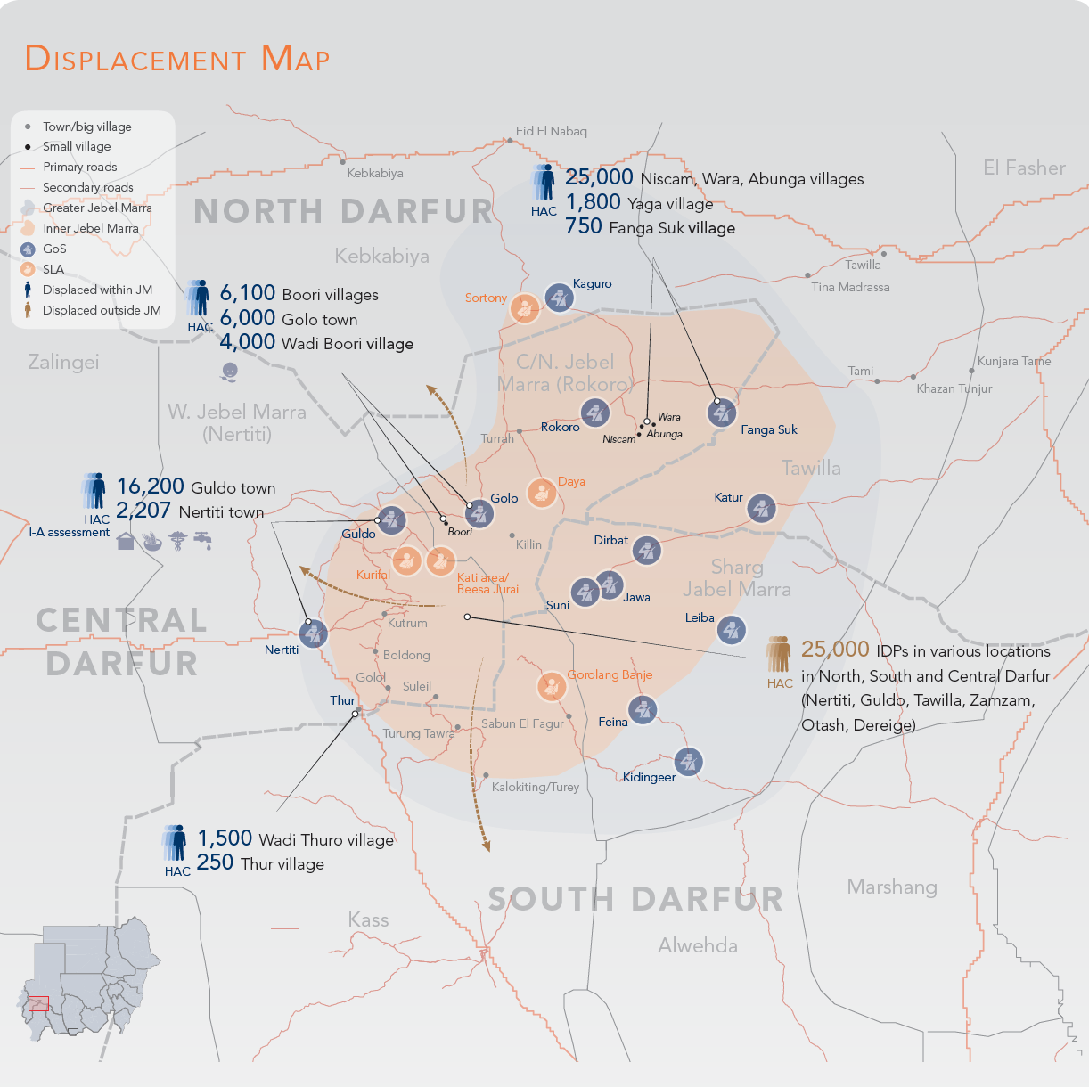
Darfur Conflict
Low Access
Limited Data
High Risk
Shifting Population
OHCA Jebel Marra 2015 Fact Sheet

Slide 3
Methodology
Reviewed best practice literature
  OECD, “Evaluating Peacebuilding Activities in Settings of Conflict and Fragility: Improving Learning for Results”
  SAVE, “Eyes and Ears on the Ground: Monitoring aid in insecure environments”
  Evaluation Methodologies for Aid in Conflict
Grouped together five key barriers to evaluations

Slide 4
Safety
There is high risk for program participants and evaluators.
Risk might result in misconstrued, misused, or inaccurate data.
Technology improves data collection but creates security risks.
Exiting post-evaluation might increase risk for the community.

Slide 5
Ethics
Evaluations might impact ongoing conflict.
Sensitivity training is important.
Gender should be addressed in evaluations.

Slide 6
Flexibility
Evaluation plans should be flexible.
Evaluation schedules should adapt to the timing of local events.

Slide 7
Data
There is a high risk of biased data.
Access to data and data collection will be limited.
There should be a balance between perception and objective-based data.
Causality will be difficult to determine.

Slide 8
Community Interaction
Difficult communication necessitates broad sets of feedback mechanisms.
Community stakeholders should be engaged from the beginning.
Contractors should not make up the majority of evaluation staff.

Slide 9
Ability to Address Obstacles to Impact Evaluation Methods in Jebel Marra, Darfur
 | Safety | Ethics | Flexibility | Data | Community Interaction
Comparison-to-Self Studies
Pre-Post Study | Medium | High | Medium | Medium | High
Post-Only Study | High | High | High | Low | Low
Interrupted Time Series | Medium | High | Low | Medium | High
Comparison Groups Studies
Simple Differences | Medium | Low | Medium | Low | Medium
Generic Control | High | High | Medium | Low | Medium
Matched Comparison Group | Low | Low | Low | Low | Medium
Propensity Score Matching | Low | Low | Low | Low | Low
Differences-in-Differences | Low | Low | Low | Low | Medium
Nonconcurrent Multiple Baseline Study | Medium | Low | Low | Low | Medium
Randomized Control Trials | Low | Low | Low | Low | Low

Slide 10
CRS Sudan Evaluation Method
Pre-Post Study
Primary data: Attitudes and knowledge assessment
Secondary data: Government MUAC data

Slide 11
CRS Sudan Evaluation Method
Safety
Ethics
Flexibility
Data
Community Interaction
Monitor situation
6 month exit strategy
Shift response
GBV indicators
Do no harm
Coordinate with ASSIST
In-country office
Primary baseline data
Official CRS guidelines
Partnering with ASSIST

Slide 12
Recommendations
 |  | Safety | Ethics | Flexibility | Data | Community Interaction
If conflict in Jebel Marra does not change… | Pre-Post Study | Medium | High | Medium | Medium | High
If conflict in Jebel Marra worsens… | Post-Only Study | High | High | High | Low | Low
If conflict in Jebel Marra improves... | Interrupted Time Series | Medium | High | Low | Medium | High

